Slide 1
Addressing the Dark Side of Vision Research: Storage [Hotstorage’17]
Goal
Improve visual processing run-times
Motivation
The storage research can strongly influence visual processing run-times:
efficient metadata storage and new storage formats for visual data.
Solution
Propose a storage architecture designed for efficient visual data access that exploits next generation hardware

Slide 2
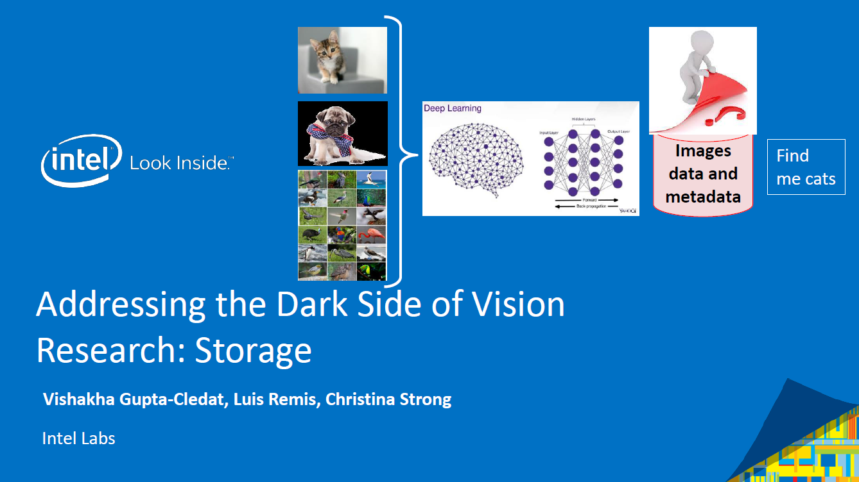

Slide 3
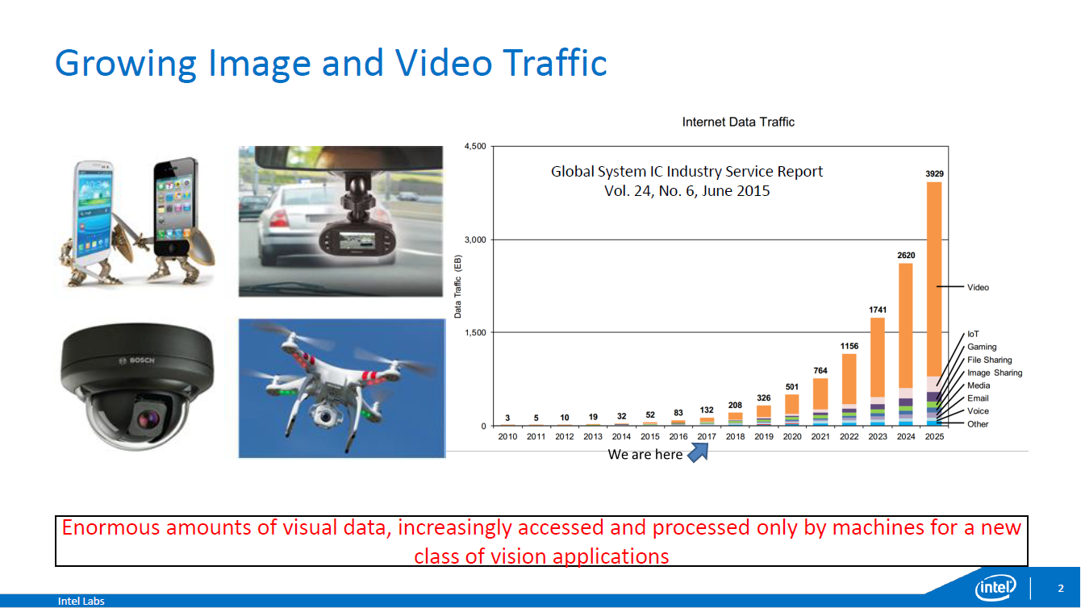

Slide 4


Slide 5
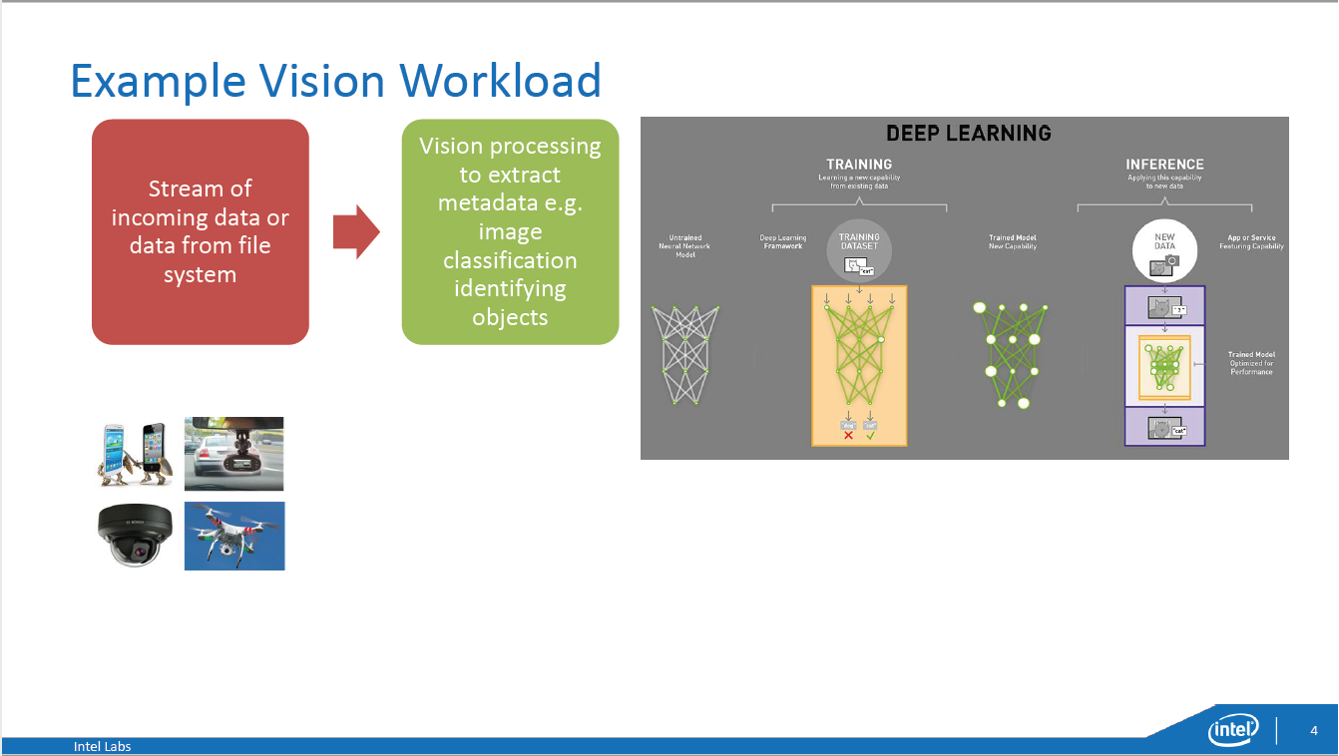

Slide 6
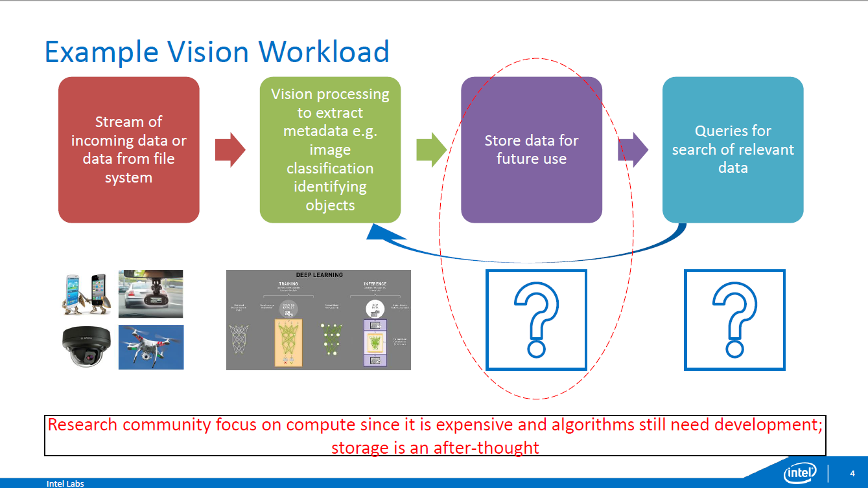

Slide 7
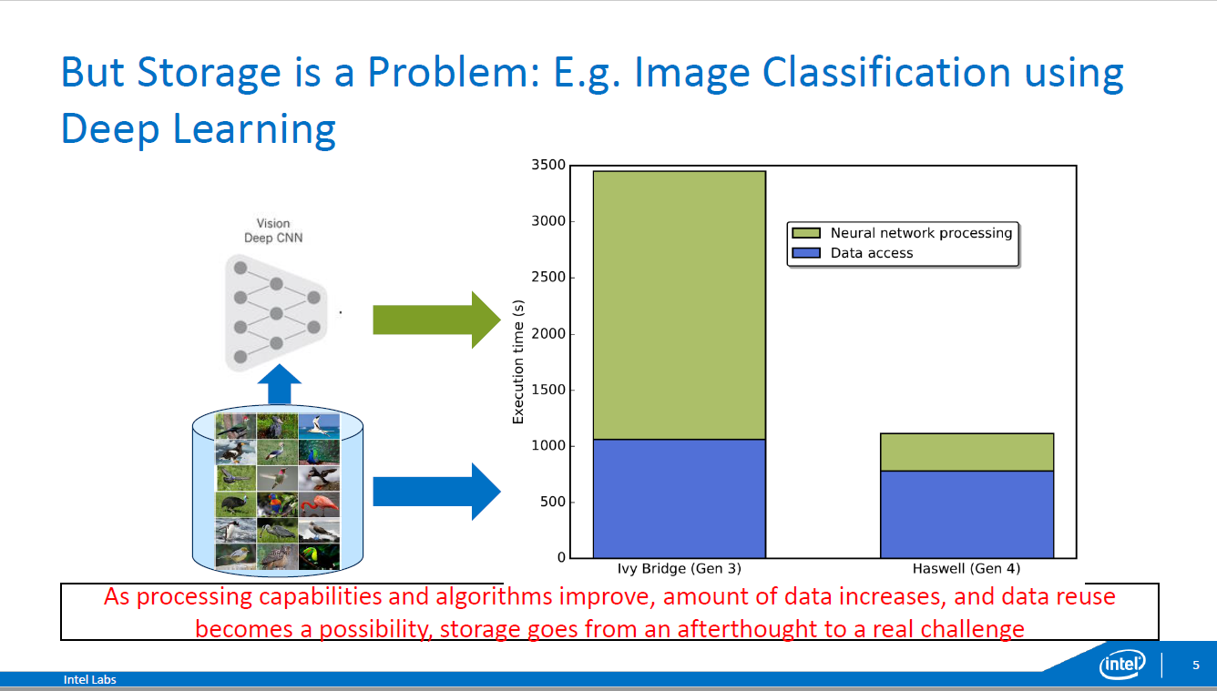
Data access time is still problematic

Slide 8
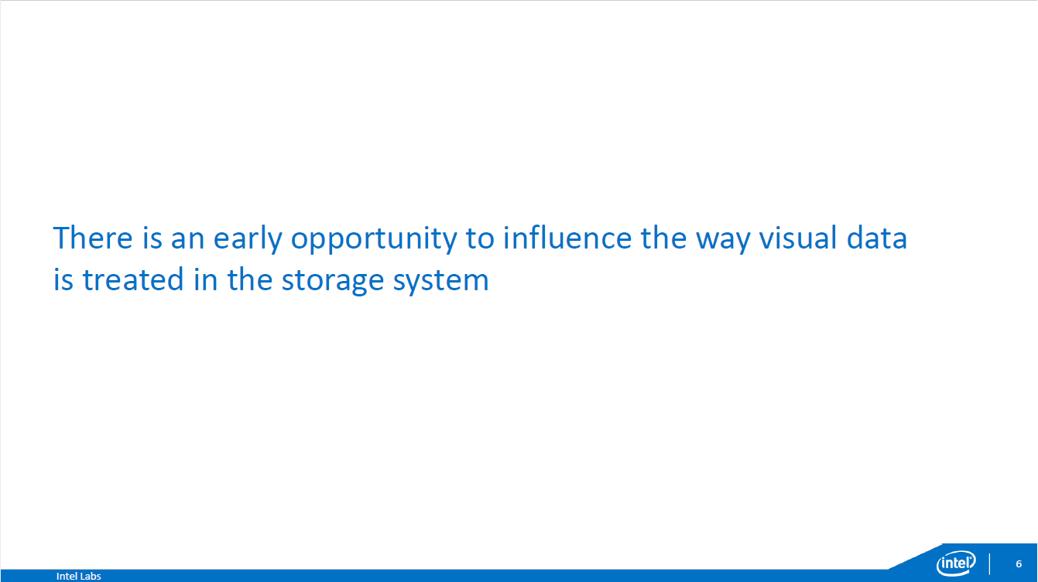

Slide 9
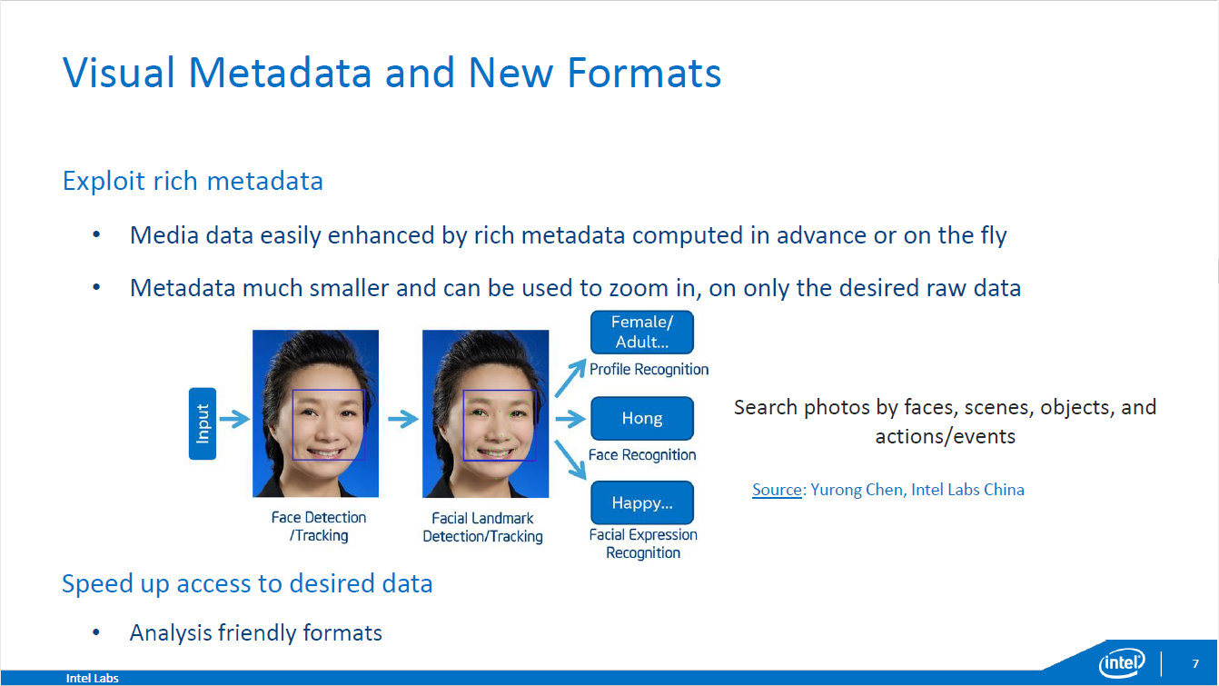

Slide 10
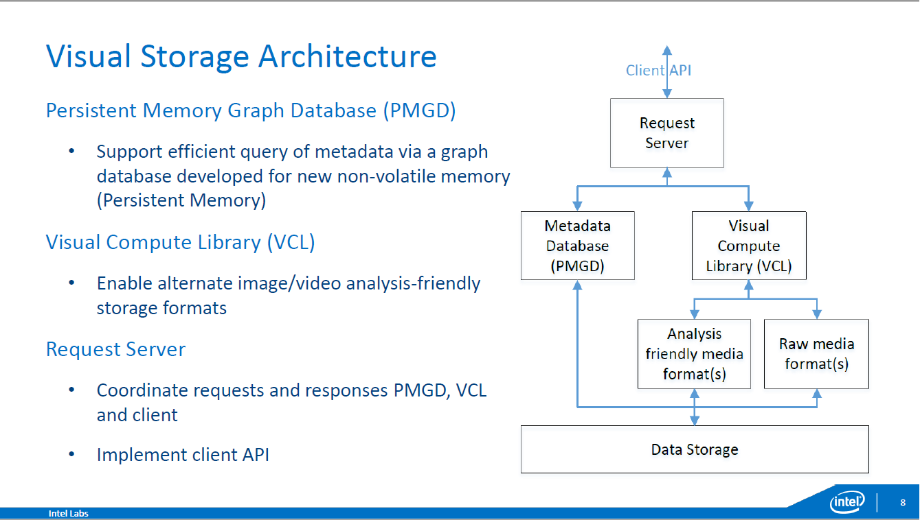

Slide 11
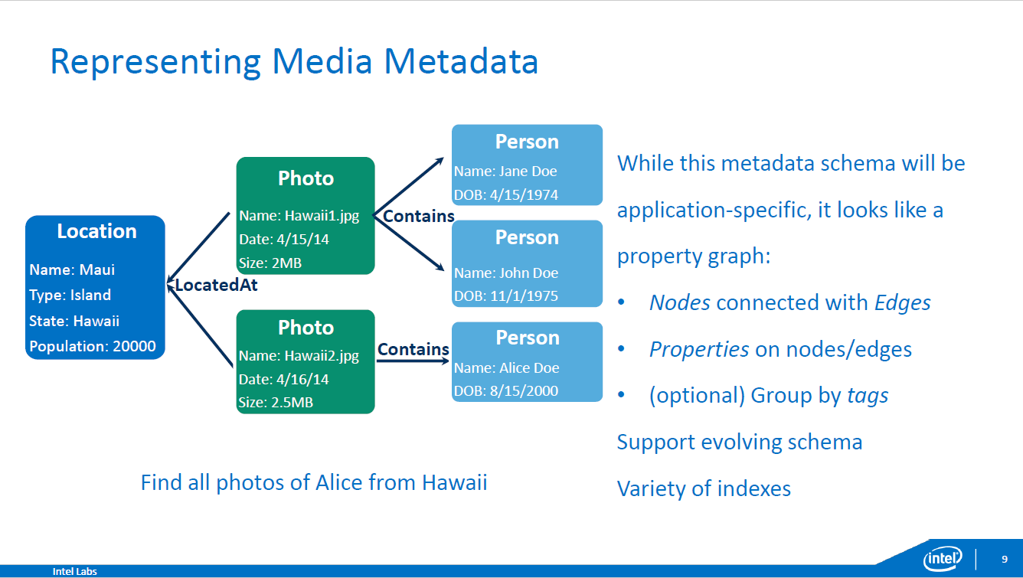

Slide 12
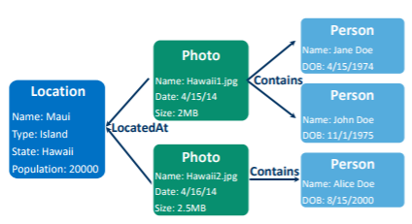
Visual Metadata as a Graph
Visual Metadata as a Graph
Property graph
Nodes connected with Edges ex. Location, Person
Properties on nodes/edges ex. LocatedAt, Contains
(optional) Group by tags
Supporting evolving scheme
Variety of indexes
Efficient compared to relational database
Graph DB: 2-hop neighbor query
Relational DB: 2 joins
Find all photos of Alice from Hawaii
Select * from Location L, Persons P, Photos Ph where L.state=P.hlocatedAt and Ph.contains=P.name and L.state=‘Hawaii’ and P.name=‘Alice’;

Slide 13
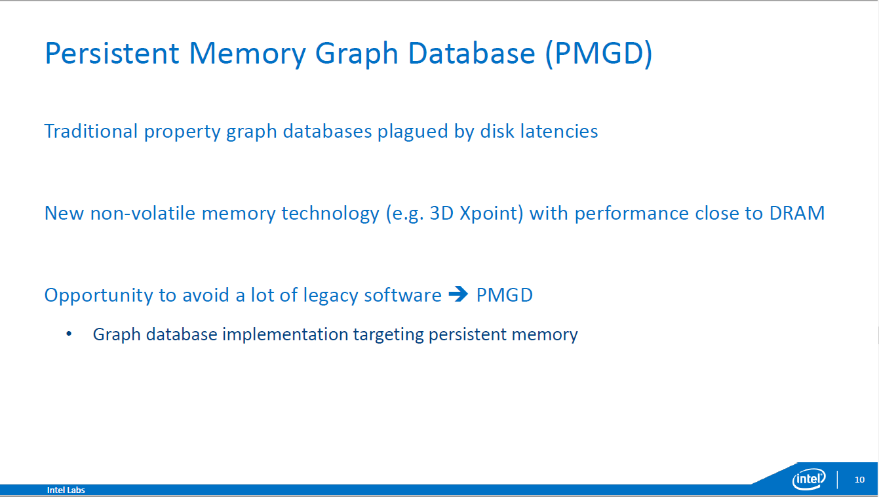

Slide 14
Persistent Memory Graph Database(PMGD)
The graph database to persist the data on disk: serialize the data to write to a block sequential device
PM(persistent memory)
Traditional graph database to persist the data on disk : serialize the data to write to a block sequential device problem
Low, predictable access time and byte-addressable nature, bypassing the data serialization step
PM caching architecture
Goal: balance between storage density(capacity) and speed of data retrieval
Graph database
Evolving scheme
Notes:
Memory bandwidth is the rate at which data can be read from or stored into a semiconductor memory by a processor. Memory bandwidth is usually expressed in units of bytes/second, though this can vary for systems with natural data sizes that are not a multiple of the commonly used 8-bit bytes.

Slide 15
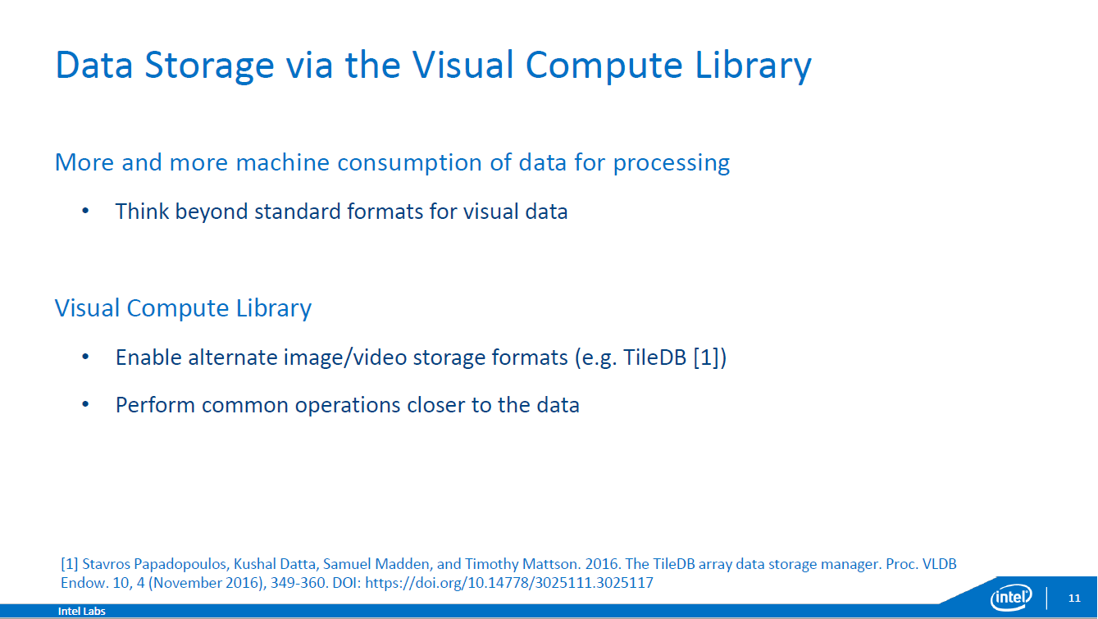

Slide 16
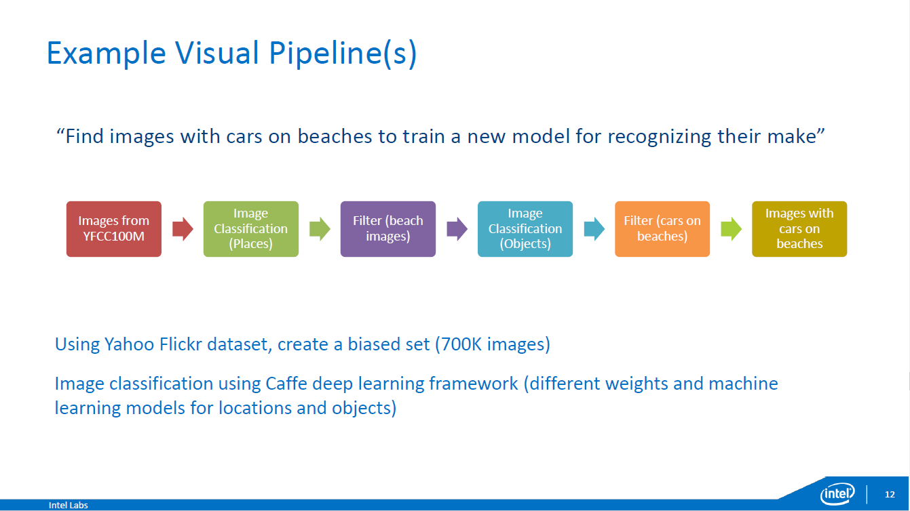

Slide 17
Metadata Query Comparison
Python_matrix(Numpy): typical approach
Store confidence value in matrix
Memsql : relational database
In-memory row store, on-disk column store
Doesn’t require buffer pool(contention problem x)
Performance in memory
Memsql_start: no query caching
Memsql_opt : multiple tries
Persistent Memory
Pmgd_pm : PMGD persisted on a SSD
Pmgd_dram: DRAM
Notes:
Memory bandwidth is the rate at which data can be read from or stored into a semiconductor memory by a processor. Memory bandwidth is usually expressed in units of bytes/second, though this can vary for systems with natural data sizes that are not a multiple of the commonly used 8-bit bytes.

Slide 18
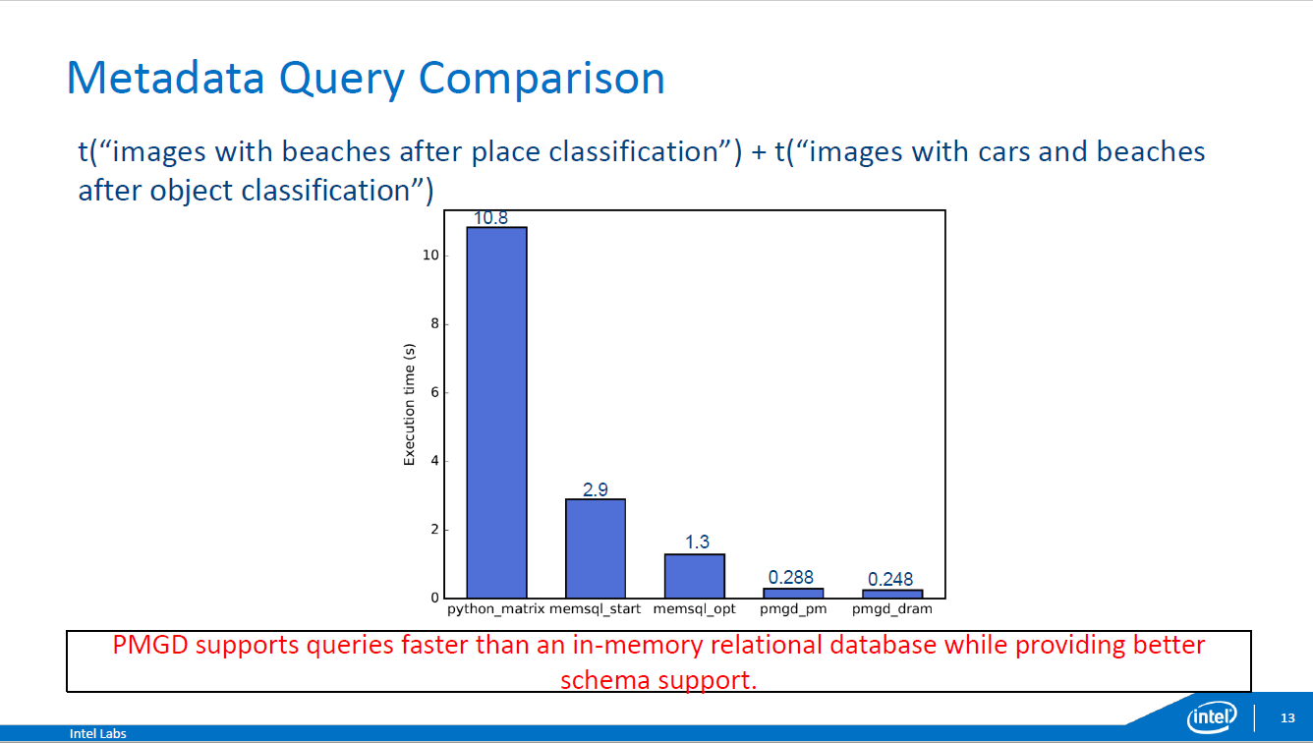

Slide 19
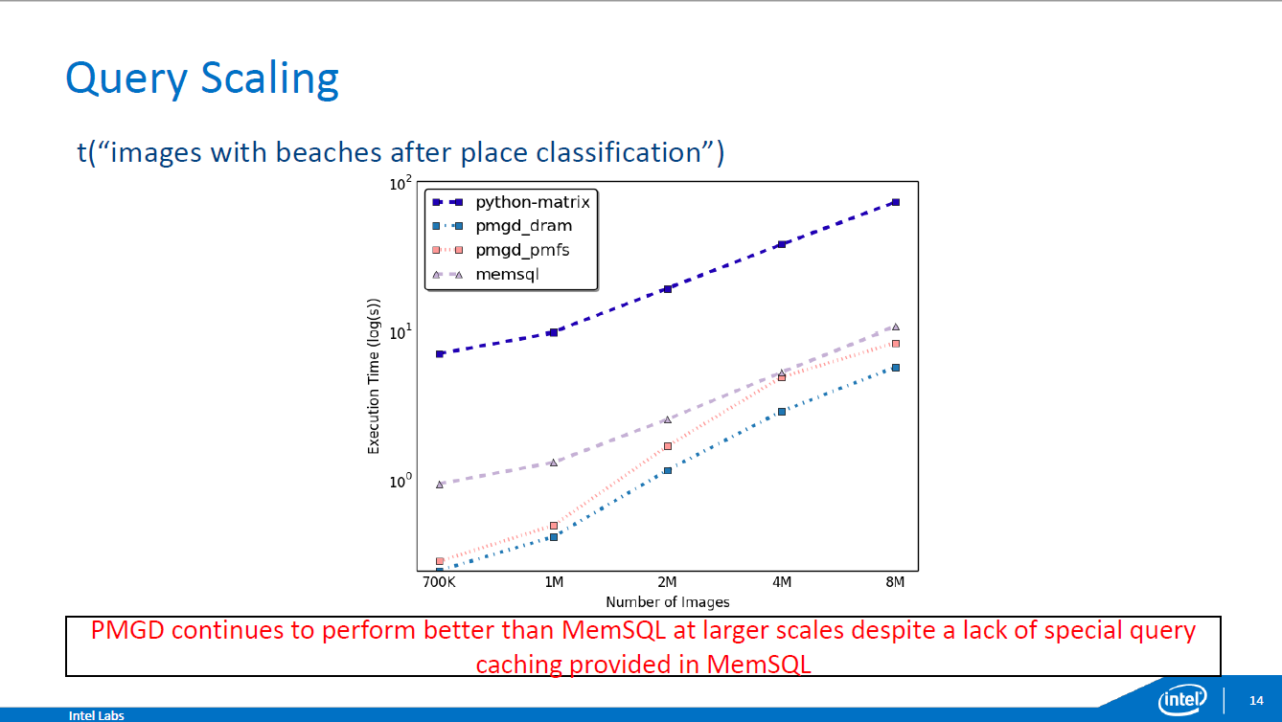

Slide 20
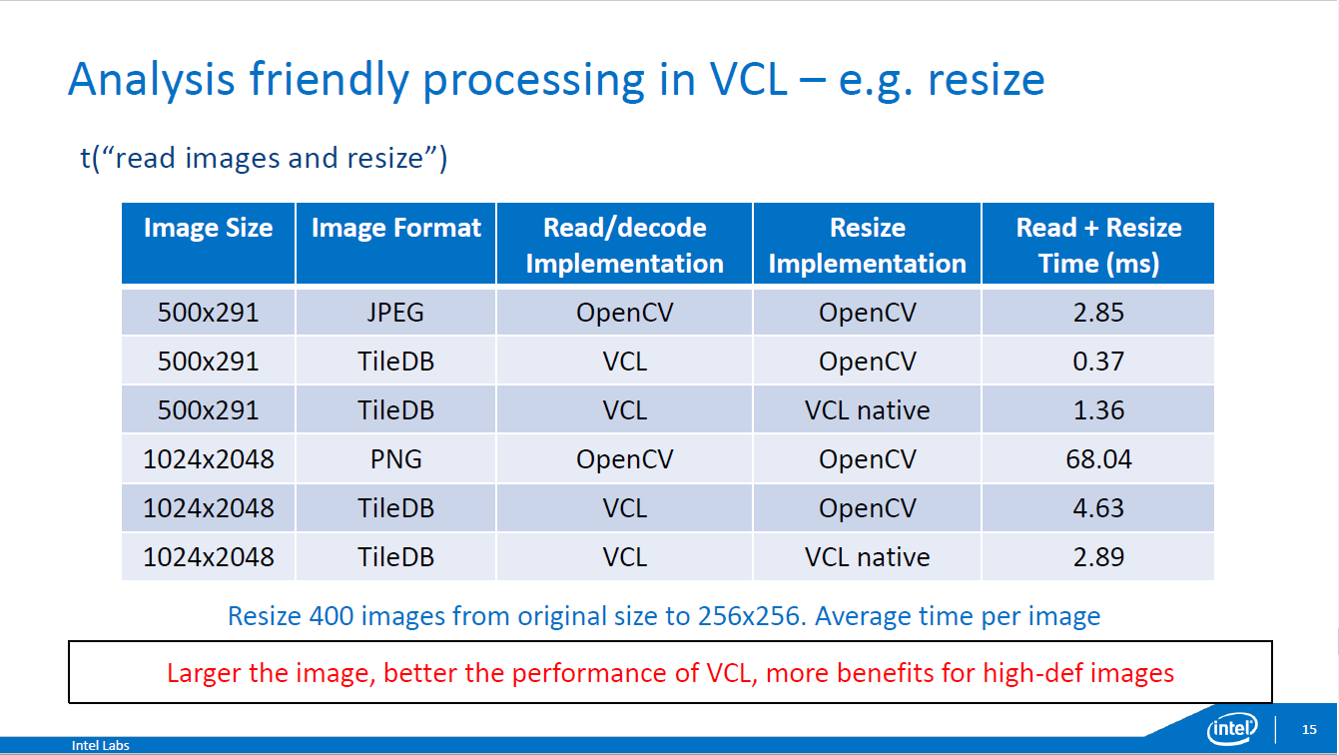
Not optimized for small size data

Slide 21
